Slide 1

Personalization and Profile
Comparative Analysis
Liz Lantz
liz.lantz@adhocteam.us
December 2021

Slide 2
Background & Goals

Slide 3
Background
Background & Goals
Through the course of working on improving the logged-in experience for Veterans, we've identified an opportunity to expand our knowledge on best practices in personalized and authenticated experiences. We frequently solicit screenshots and log into our own accounts to learn from other sites, but haven't formalized any documentation around this.
The goal of this activity is to answer specific research questions and create a knowledge base of authenticated experiences to share with our team, especially those who are new to this field of user experience.
We want it to be clear that moving forward in these findings, we're referring to personalization not customization. What's the difference? We're glad you asked.

Slide 4
Customization is done by the user. Personalization is done by the technology.

Slide 5
Research goals
Background & Goals
Get a sense for differences in personalized experiences for civic services compared to the private sector
Understand content and language commonly used in a logged-in state
Compare aspects of the VA.gov authenticated experience to the logged-in state of other sites
Learn how sites encourage profile completeness

Slide 6
Methodology

Slide 7
Method
Methodology
We conducted a comparative analysis of sites in government, banking, student loan, and insurance industries since they serve as a good model for the VA.gov use cases. We also included a few sites outside of these sectors since we've heard Veterans mention them repeatedly in research studies. The scope of this research was limited to desktop and mobile versions of sites (not apps). We used our own accounts to log in when possible, and otherwise solicited screenshots from colleagues. To learn about GOV.uk's account experience, we conducted a semi-structured interview with a Senior UX Designer on their Account Experience team.

Slide 8
Research questions
Methodology
What, if anything, is different about personalization of civic services compared to the private sector (banking, insurance)?
What information about users do sites commonly show in a logged-in state?
How do the conventions we see align with what we're doing on VA.gov, especially when it comes to profile IA and terminology?
How do sites encourage profile completeness?
How do sites handle removing/deleting profile information?
What are other governments doing?

Slide 9
Reviewed websites
Methodology
We first planned our research by categories and tasks we wanted to evaluate. Then, we identified sites that made sense to look at based on those groupings:
Manage benefits, claims (view / history) CareFirst Blue Cross Blue Shield State Farm USAA Healthcare.gov | Payments, transactions (view / history) Bank of America / Merrill Lynch Fidelity Investments Chase Citicards Federal Student Aid
Government USA Jobs / Login.gov Global Entry GOV.uk | Personalization, identity* Google Reddit Facebook * In multiple user interviews, Veterans have stated that they use or reference these sites

Slide 10
Research Findings

Slide 11
Key Findings
Research Findings
1. Personalization 1.1 Both civic and private personalized services seek to establish a sense of trust and familiarity.
1.2 There are key differences in how private sector and civic services provide personalization.
1.3 There are 3 common personalized items shown in a logged-in state.
1.4 One difference in the authenticated experience (AE) on VA.gov compared to other sites is the logged-in homepage.
1.5 Another key difference in the AE on VA.gov compared to other sites: the information architecture.
1.6 There isn't a clear best practice or trend for using "My" or "Your" in a personalized experience. 2. Profile
2.1 Interrupt modals and notifications are common approaches to encourage people to complete their profile information.
2.2 Most sites don't allow people to remove primary contact information from their profile.
2.3 The sections of the VA.gov profile are well aligned with other sites.
3. GOV.UK
3.1 GOV.UK is in early stages of personalized user experience.

Slide 12
1. Personalization

Slide 13
Both civic and private personalized services seek to establish a sense of trust and familiarity.
Research Findings
They build a sense of knowing the user's needs and motivations by:
Reflecting known information about a user, such as their name, recent activity, and an overview of their accounts or items in-progress.
Surfacing tailored recommendations, as well as relevant content and tasks. Examples include:
Offering the ability to set an alert or notification for an important task.
Recommending relevant services to complement something the user is already engaging with.

Slide 14
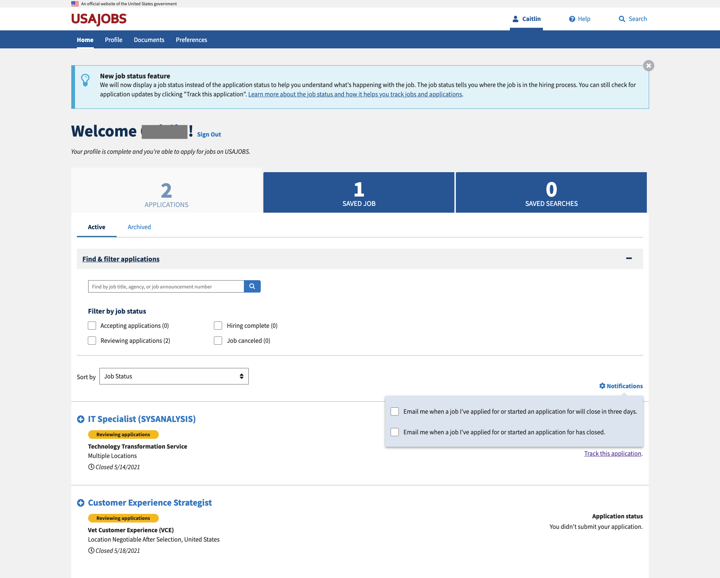
USA Jobs adds the user's first name (removed for privacy) to their navigation and welcome messages and prioritizes in-progress applications. They also provide easy access to user-defined saved jobs and searches and aim to ease the user’s burden by offering to send notifications about important in-progress items.

Slide 15
There are key differences in how private sector and civic services provide personalization.
Research Findings
On private sector sites, we noticed:
One-to-one marketing
Includes retargeting users with ads or providing recommendations on similar products based on what they’ve already looked at.
Can have a "creepy" factor
Dedicated real estate on web pages for marketing and services, such as reward programs and special offers.
More robust options for managing personal information such as the ability to add multiple addresses, phone numbers, account nicknames, etc.

Slide 16
There are key differences in how private sector and civic services provide personalization.
Research Findings
Private Sector | Civic Services
One-to-one marketing Includes retargeting users with ads or providing recommendations on similar products based on what they’ve already looked at. Can have a "creepy" factor Dedicated real estate on web pages for marketing and services, such as reward programs and special offers. More robust options for managing personal information such as the ability to add multiple addresses, phone numbers, account nicknames, etc. | The variety of touchpoints across agencies in the government can make integration challenging and cause a lack of cross-departmental links and access points. Typically face more significant security and technology constraints than the private sector. Take a basic approach to personalization that reflected 2-3 personalized items (recent activity was most common) upon logging in, compared to 4-5 items on private sector sites. A focus on only 1-2 primary tasks. This makes sense given that the sites typically provide specific civic services that users cannot receive elsewhere.

Slide 17
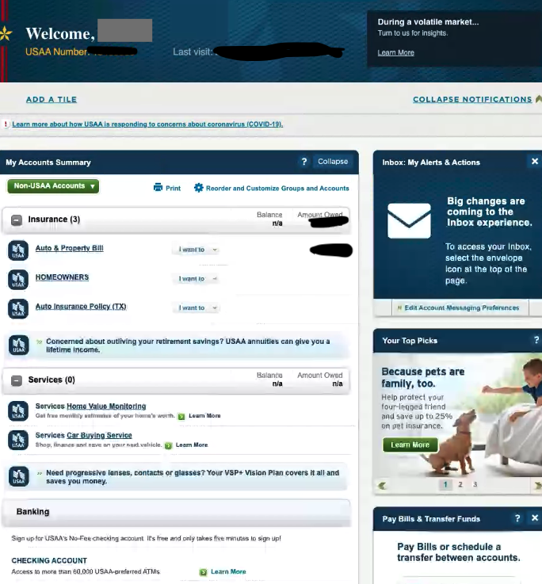
Example: Private sector site
Research Findings
On their dashboard, USAA gives customers the ability to customize their view (add a tile, reorder and customize), dedicates space for marketing, and serves up suggested products within the account summary.

Slide 18
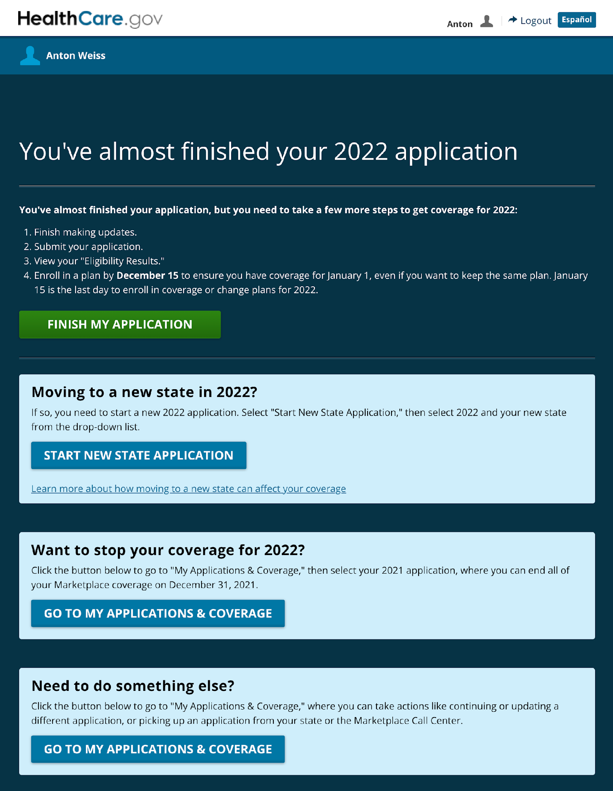
Example: Civic service site
Research Findings
Upon logging in, Healthcare.gov focuses the user on the primary task of completing their application in progress. As a secondary focus, another important application is surfaced to make it easy for the user to find.

Slide 19
There are 3 common personalized items shown in a logged-in state.
Research Findings
Personalized info | # of sites (of 15)
First name | 10
Alerts / notifications | 8
Overview of accounts | 9
Member id | 4
Greeting (e.g. Welcome) | 4
Recent activity or status | 4
Transactions | 3
Earned rewards | 3
Group number | 2
Custom feed | 2
Recommendations | 2
Enrollment date | 2
Last name | 2
User name | 1
Membership level | 1
Email address | 1
Custom ads | 1
Language preference | 1
Groups | 1
Additional user settings to further personalize | 1
Across the sites we reviewed, the user's first name, account summary and action items/notifications were displayed on a user's logged-in homepage to create a sense of personalization.
We counted 20 points of personalization in total, but most were one-offs and not common across sites.

Slide 20
One difference in the authenticated experience (AE) on VA.gov compared to other sites is the logged-in homepage.
Research Findings
Almost every site (Google being the only exception) we visited had an authenticated homepage with personalized content upon logging in, which was very different from the unauthenticated homepage.
The authenticated homepage on these sites was very similar to My VA:
Focused on the user's account
Provide direct access to in-progress tasks
Surfacing other relevant, helpful links.

Slide 21
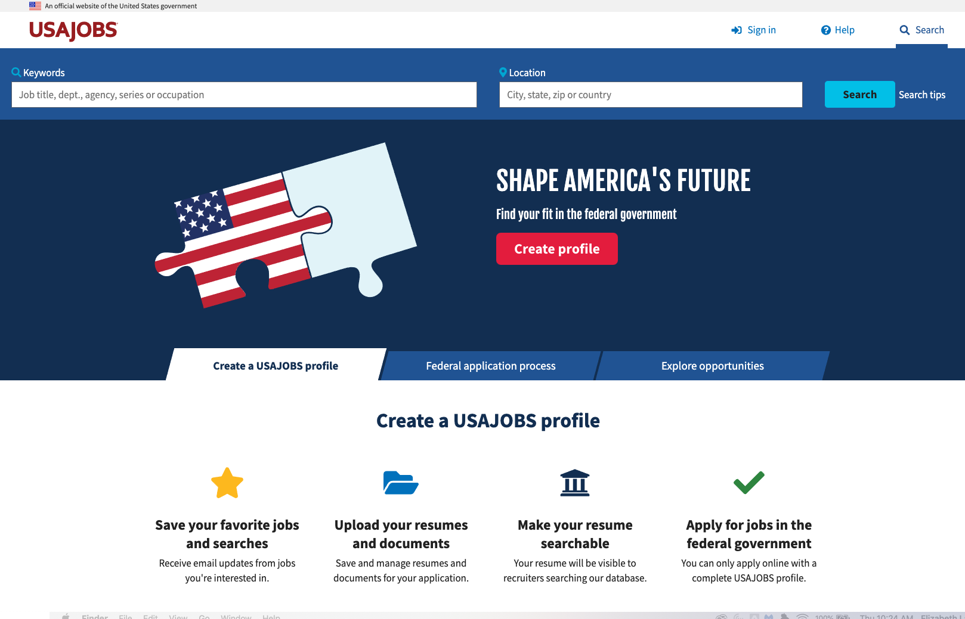
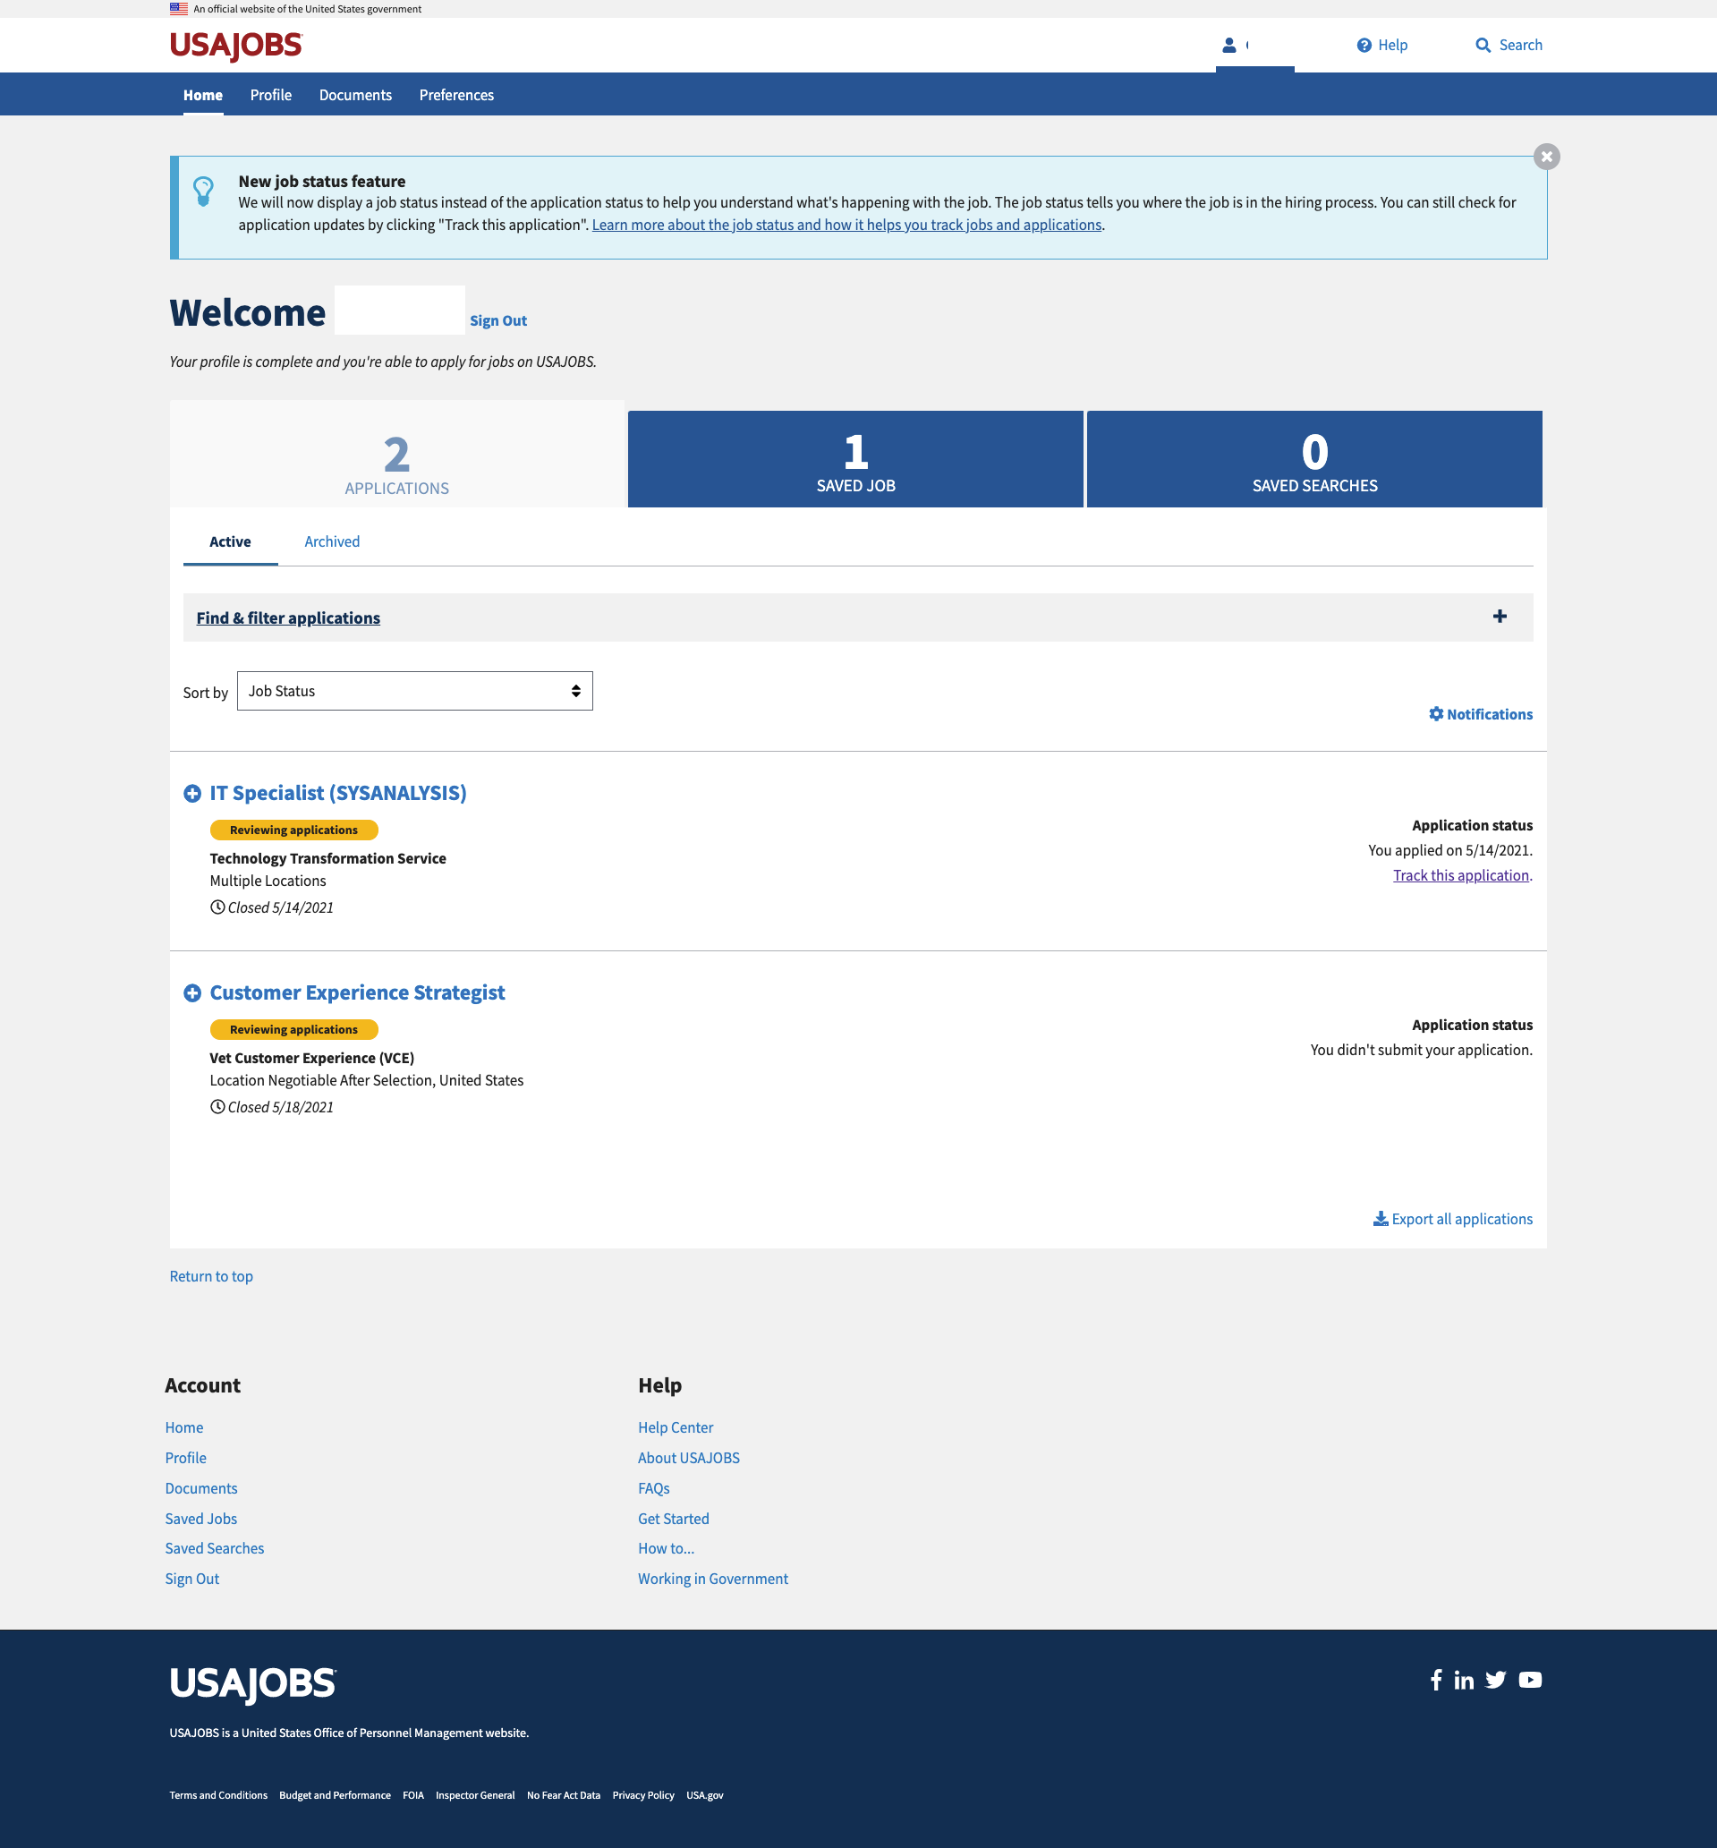
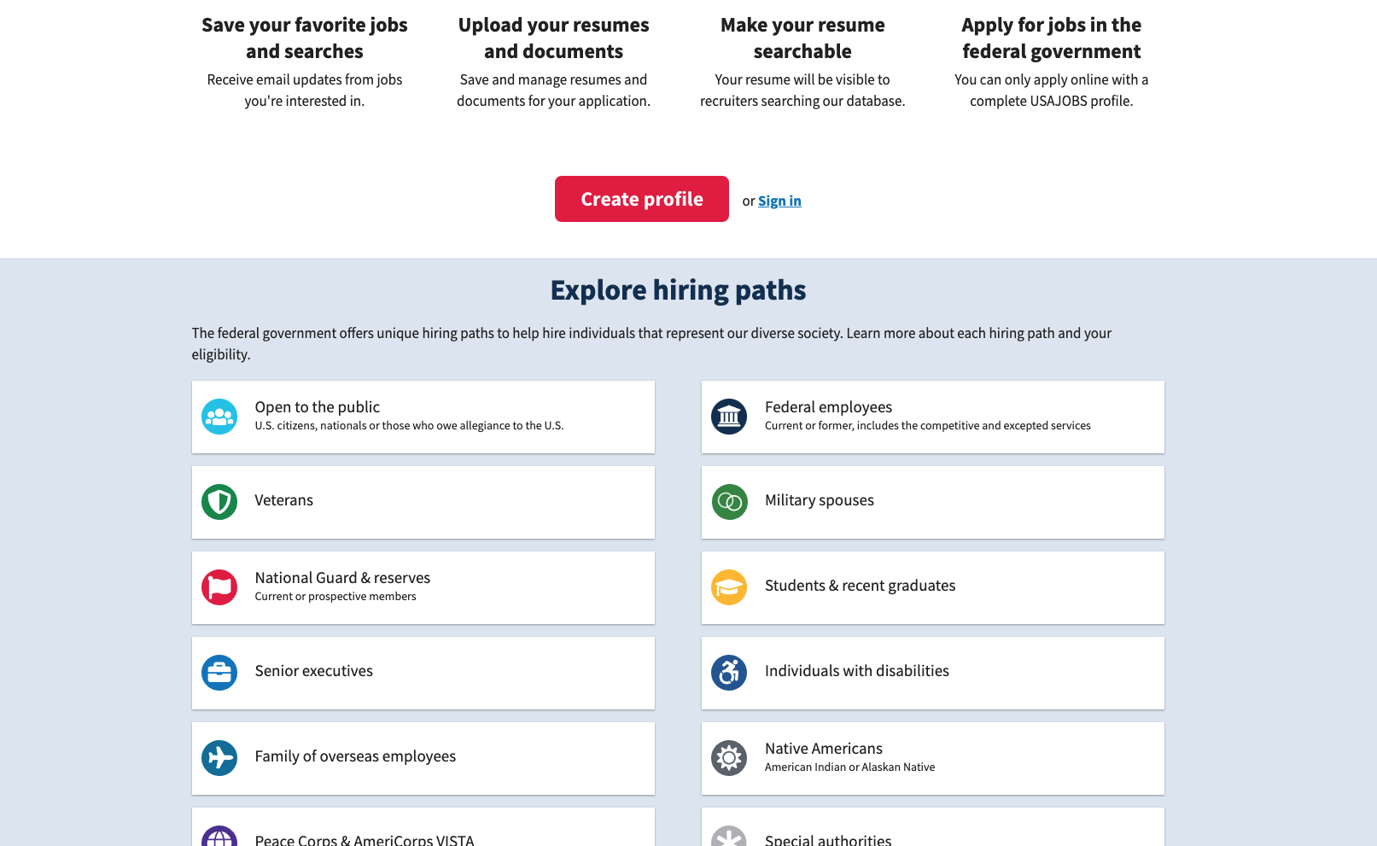
Examples of logged-out vs logged-in homepages
Research Findings

Slide 22
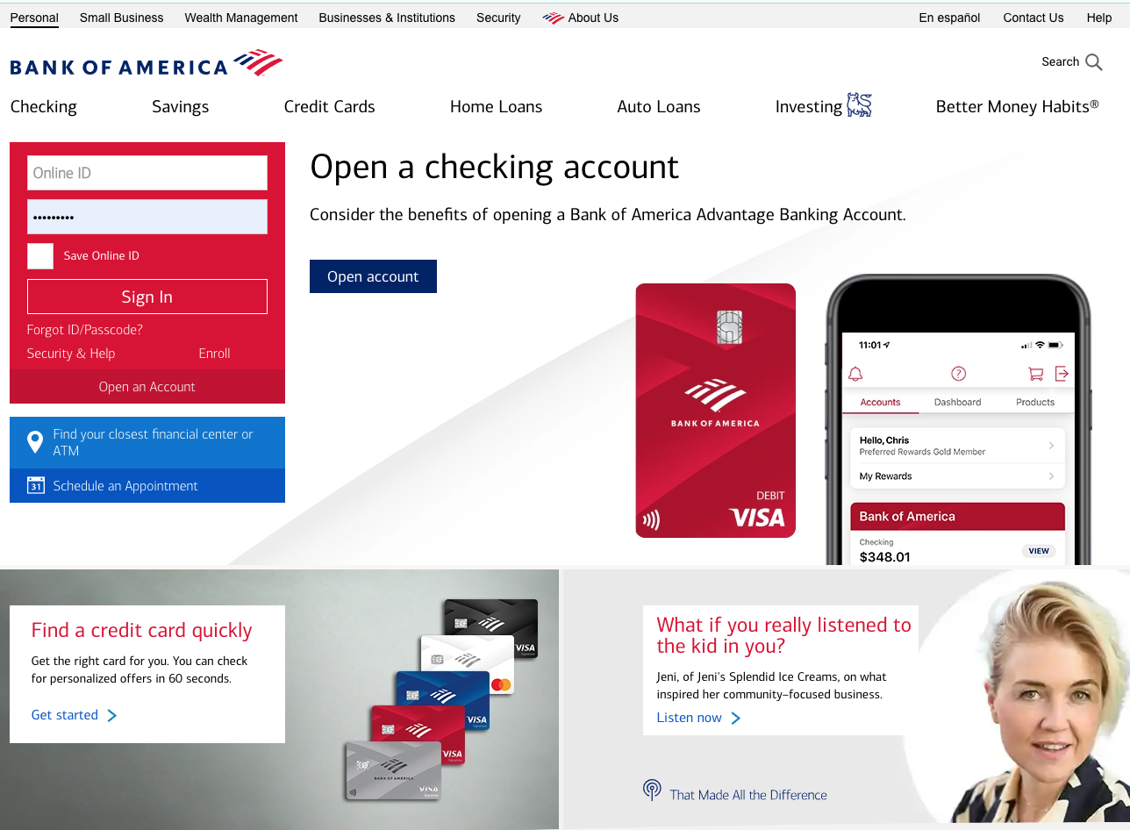
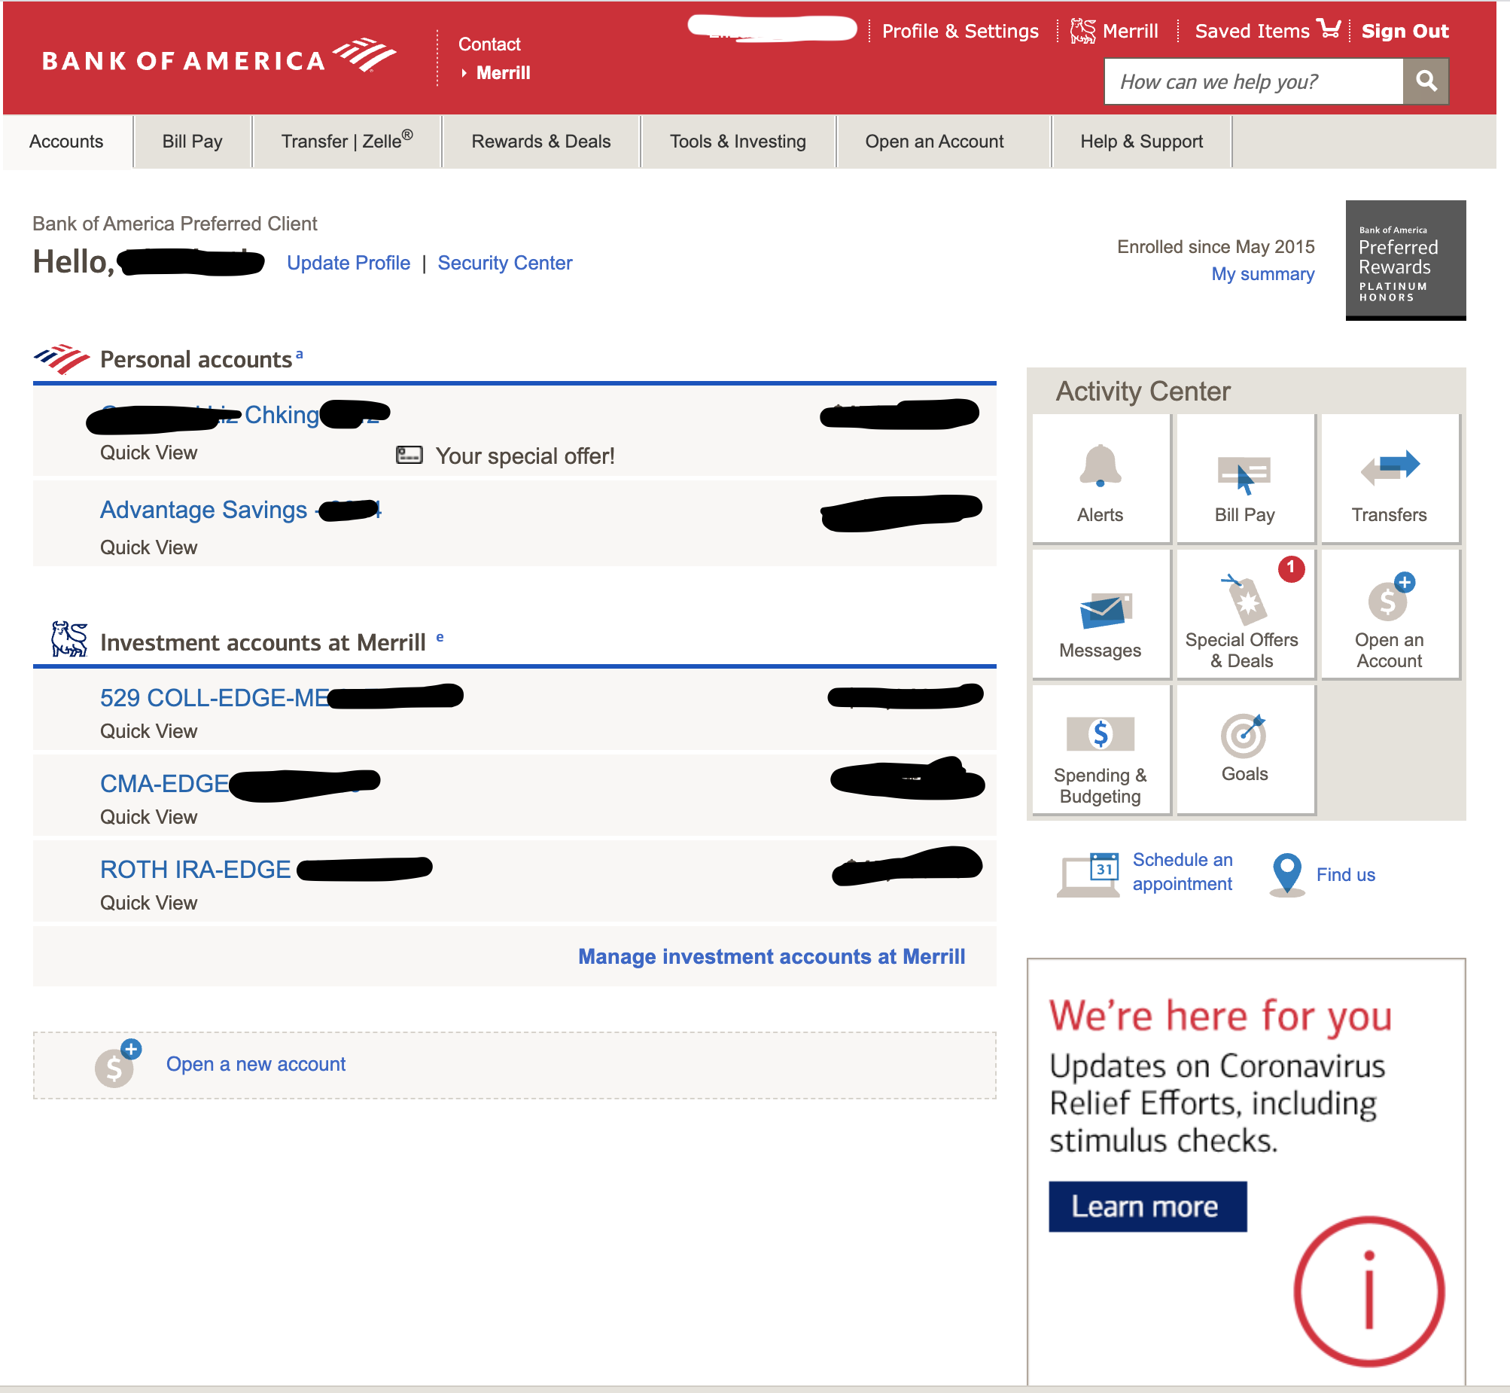
Examples of logged-out vs logged-in homepages
Research Findings

Slide 23
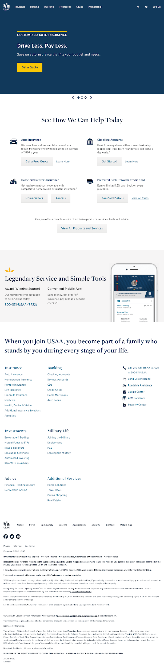
Examples of logged-out vs logged-in homepages
Research Findings

Slide 24
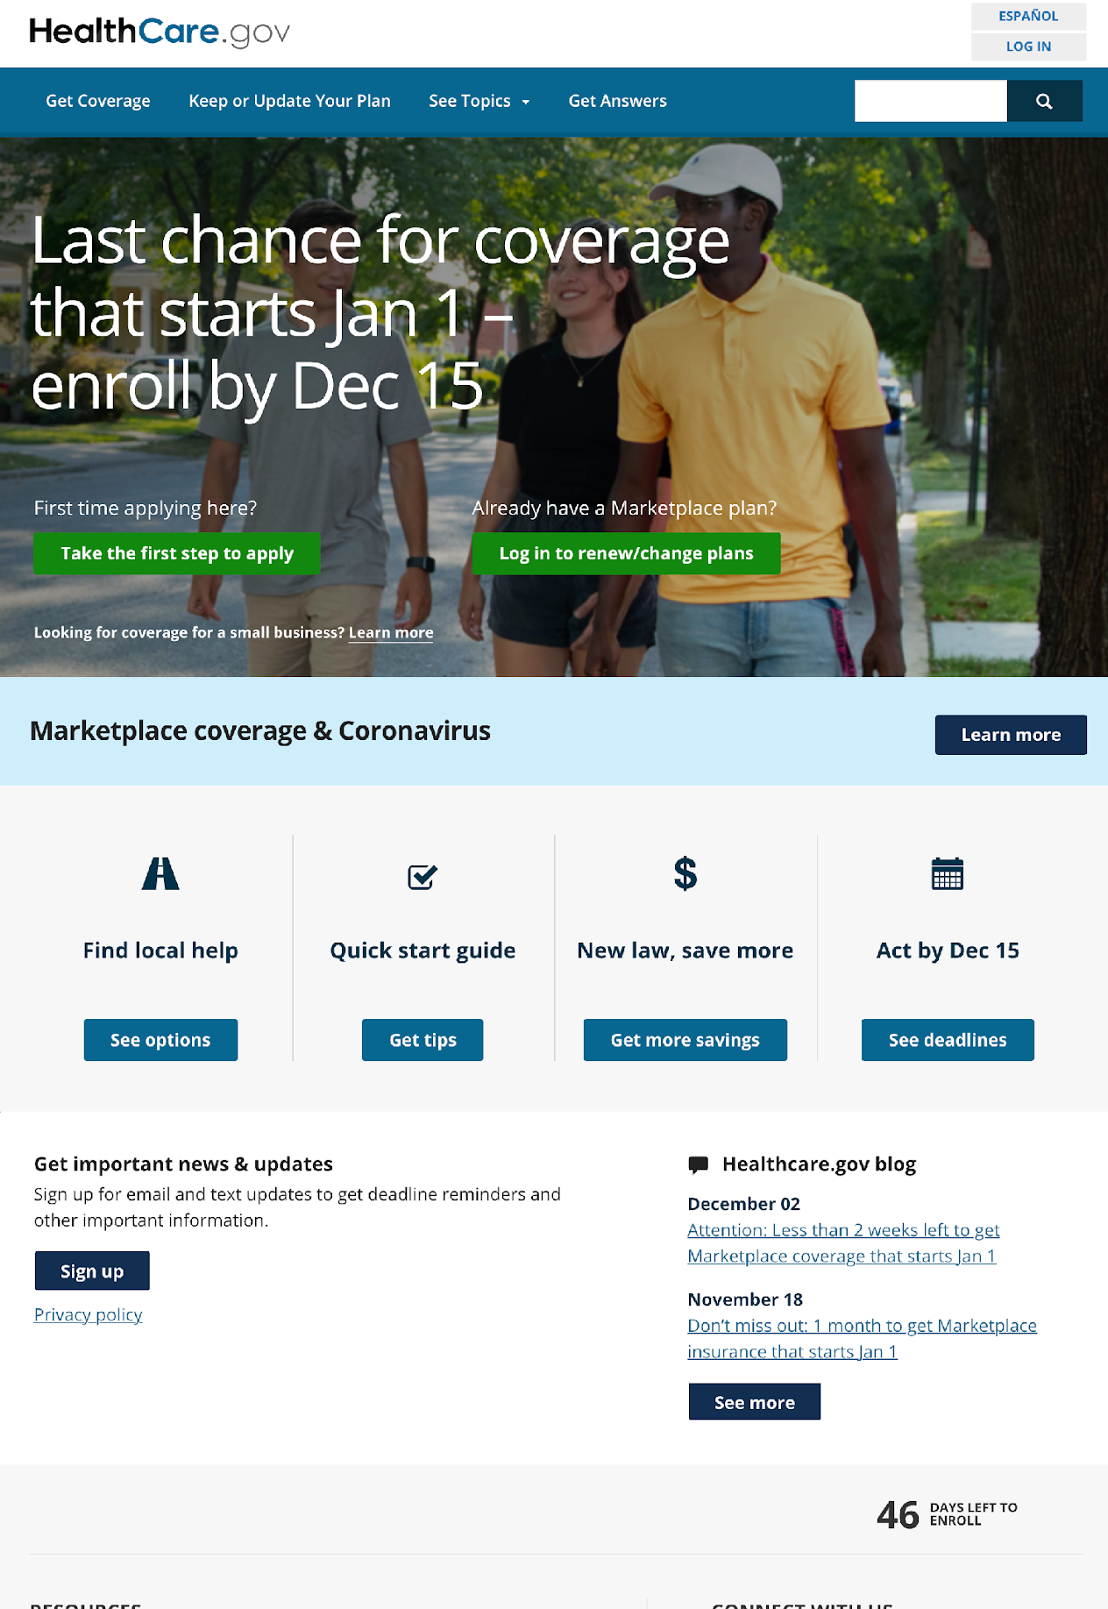
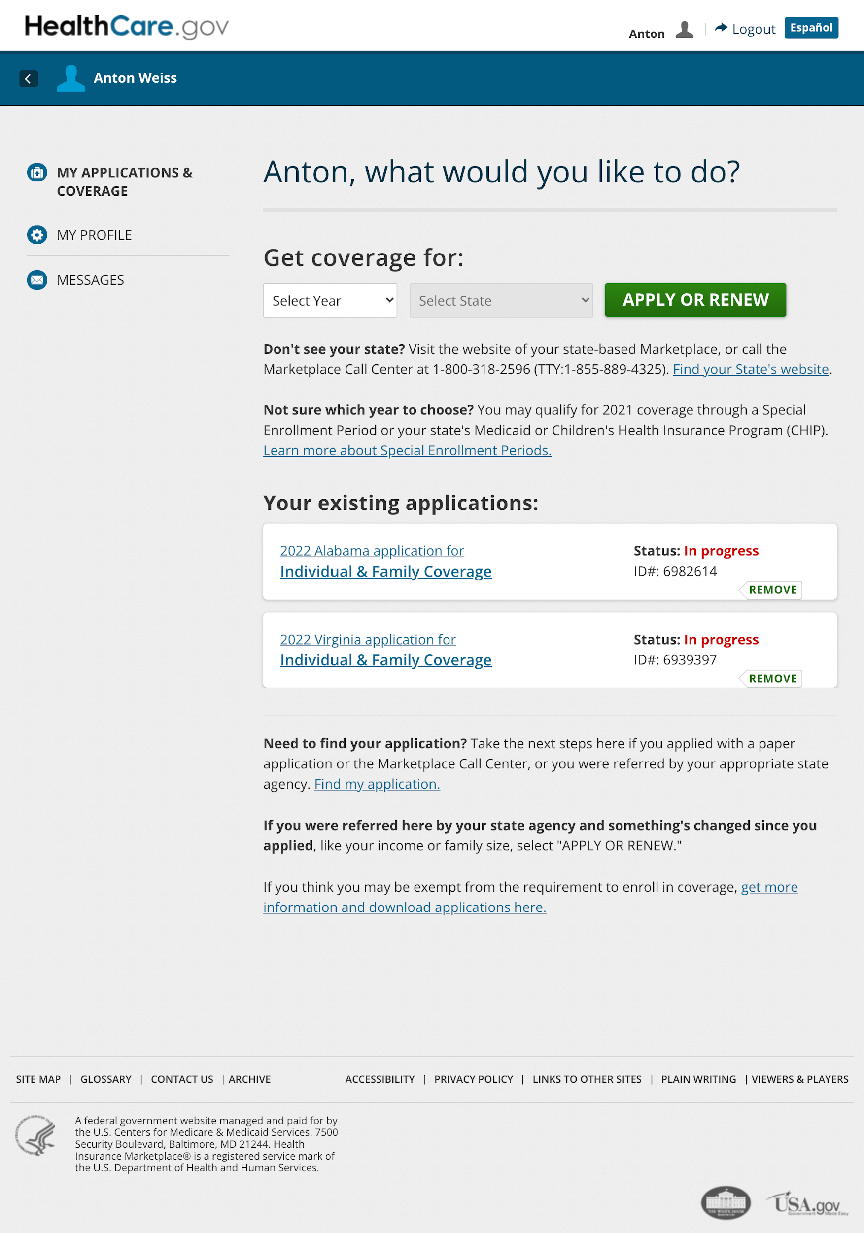
Examples of logged-out vs logged-in homepages
Research Findings

Slide 25
Another key difference in the AE on VA.gov compared to other sites: the information architecture.
Research Findings
Another difference we noticed was in the information architecture after logging in – most sites had more distinct breakdown for personalized content at the main navigation level than we do on VA.gov. Of the 15 sites we reviewed:
7 had a navigation point with the label "Profile" in the authenticated main menu.
3 of these included an additional label to add more information about what lives in that section. Examples include "Profile and Settings" and "My profile & preferences"
3 others had a separate navigation point for settings and preferences.
Instead of "Profile", 8 used alternate labels such as "User settings" or "Personal information"
Most of the sites also had completely different navigation after logging in.

Slide 26
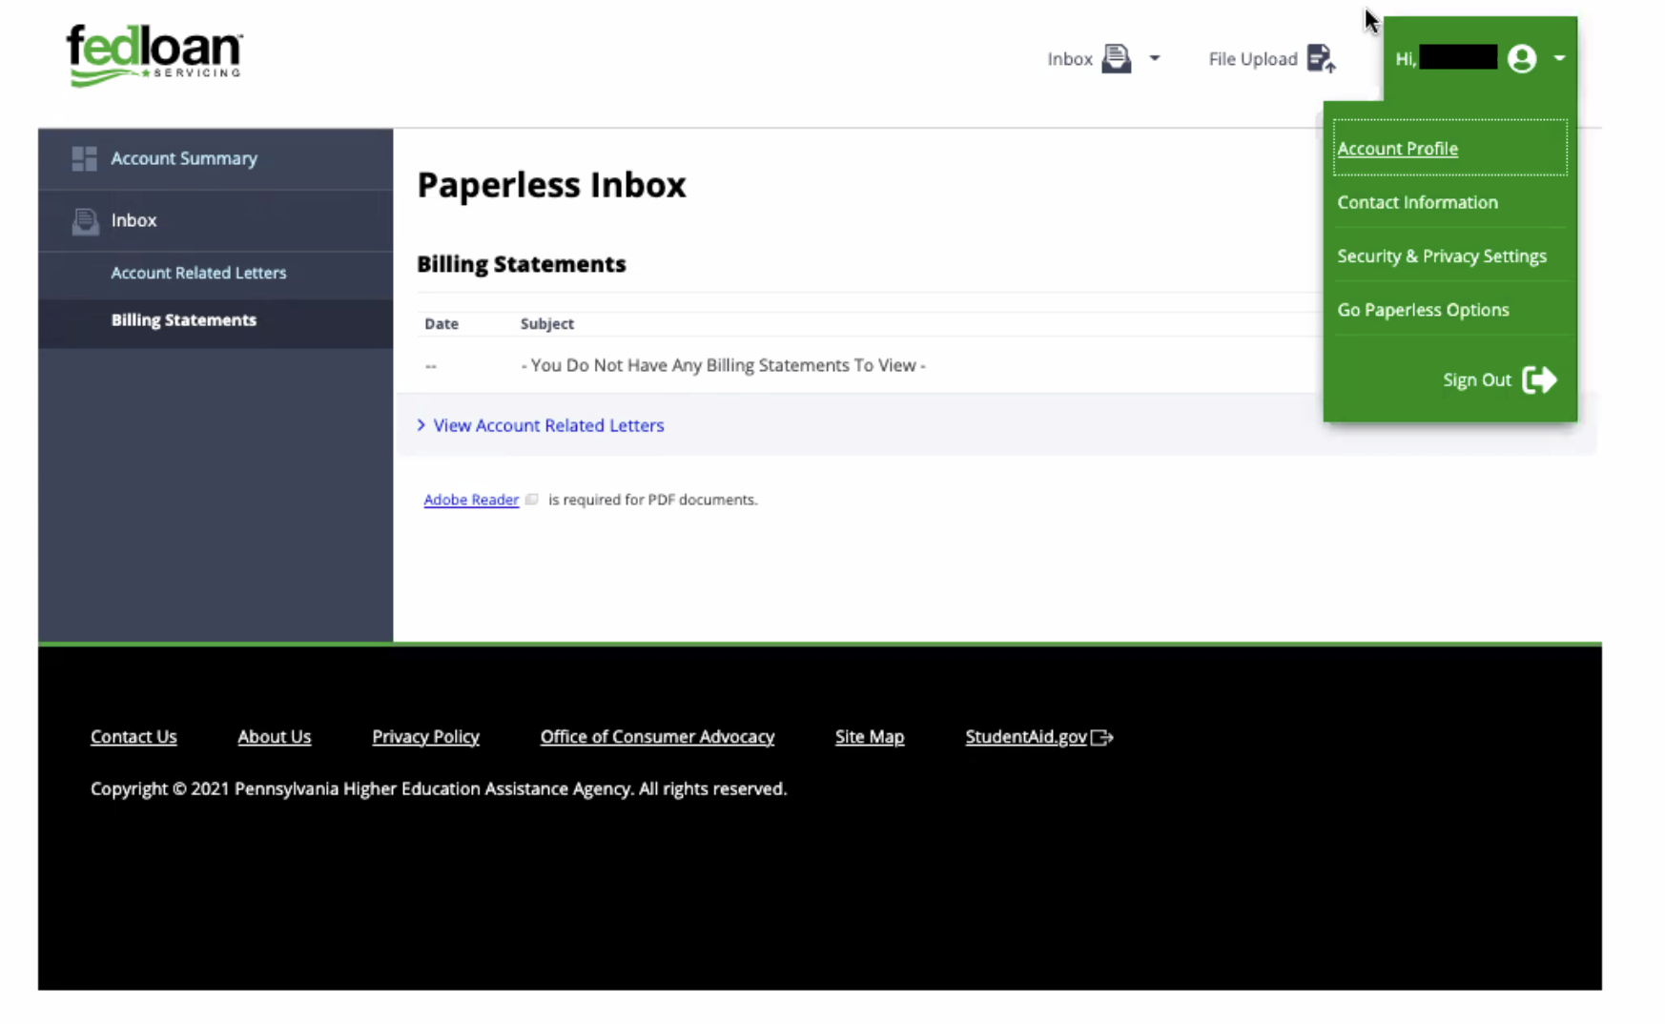
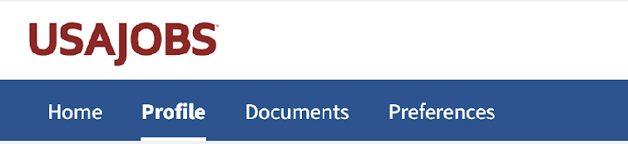
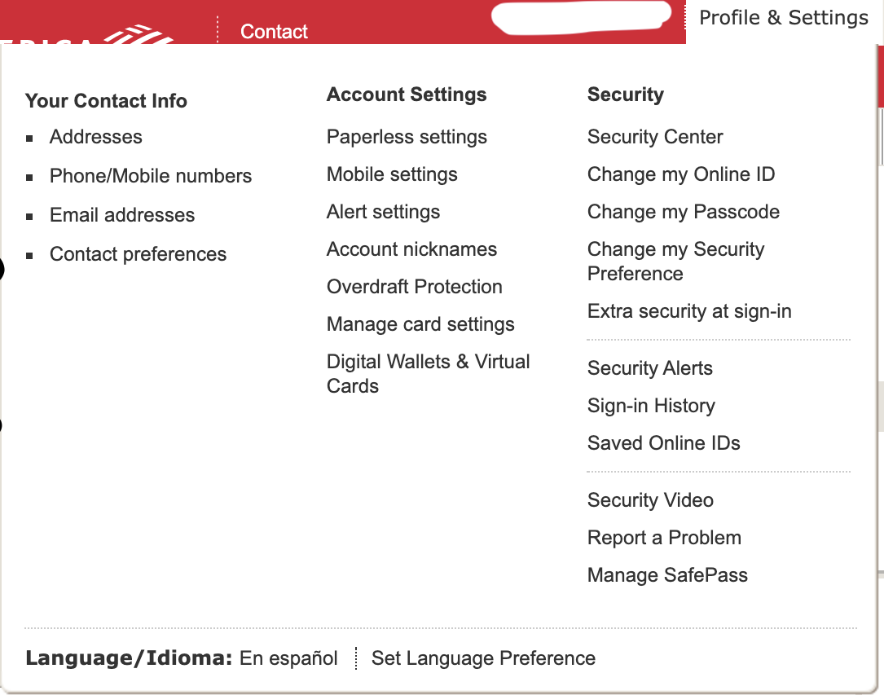
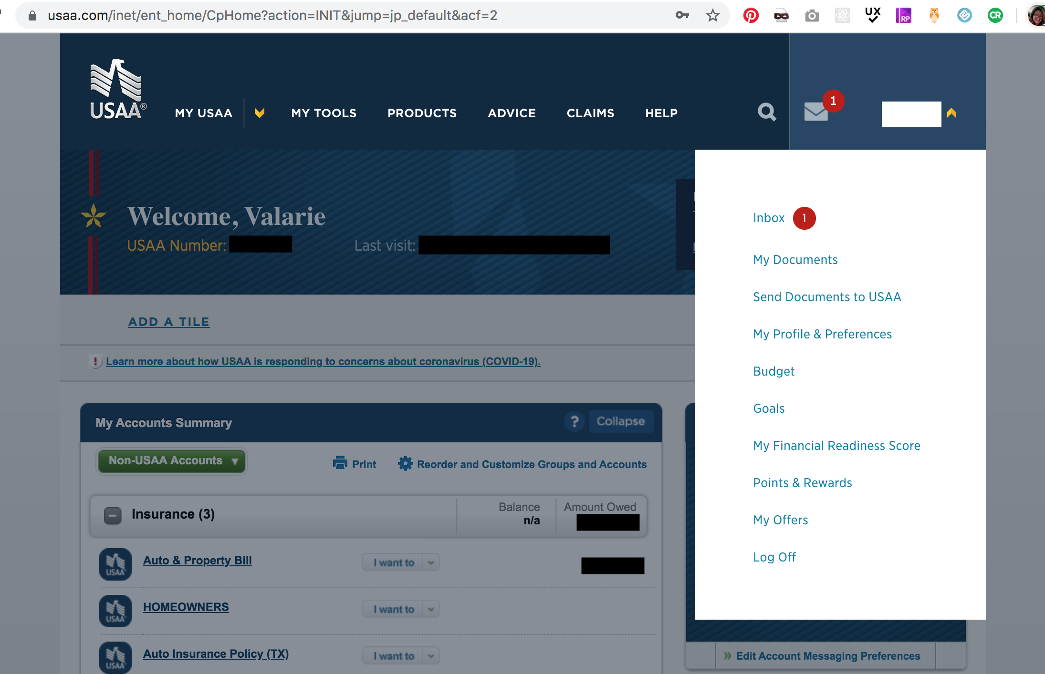
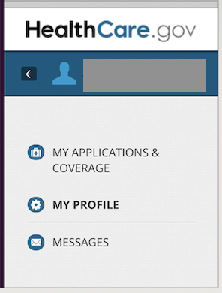
Examples of profile navigation and IA
Research Findings

Slide 27
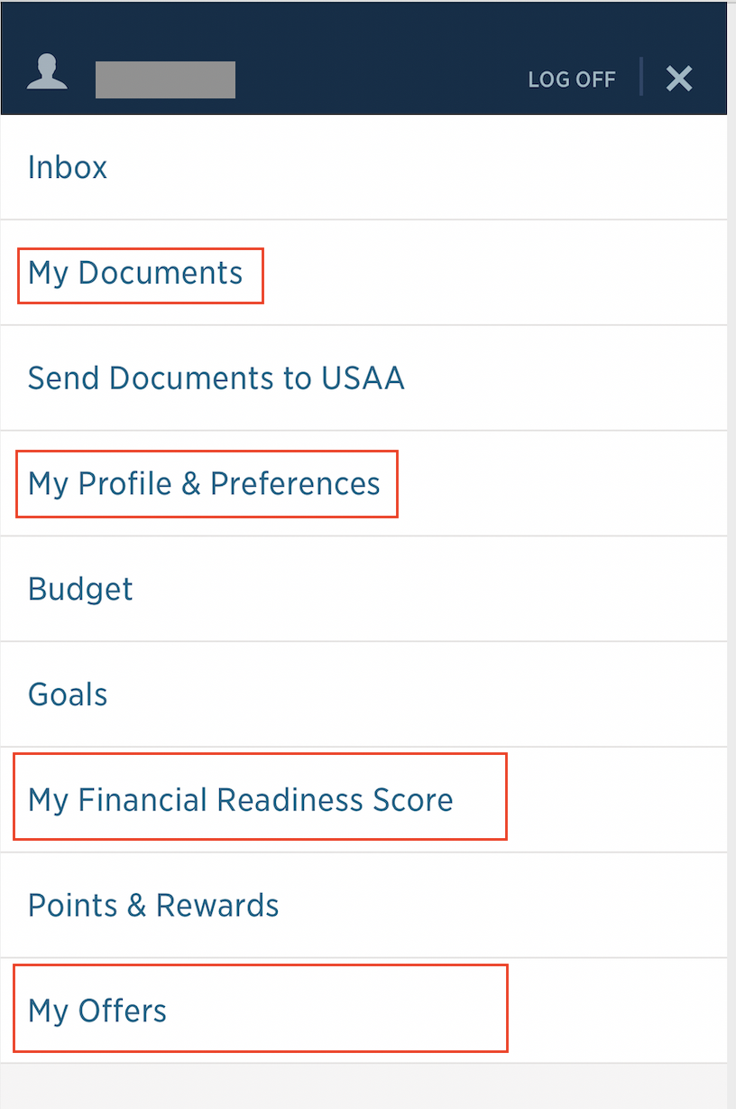
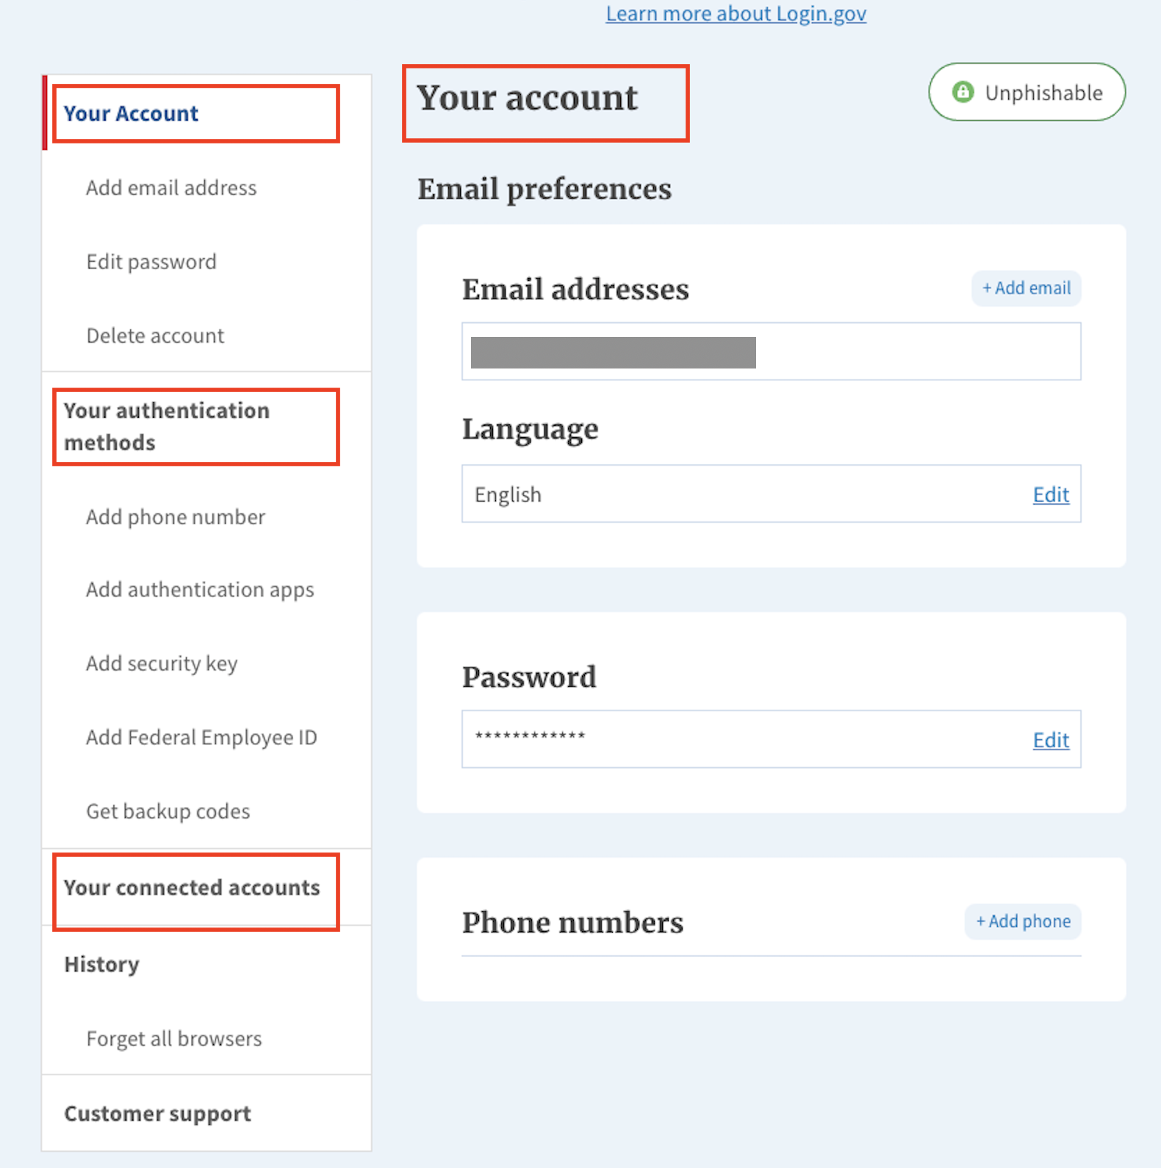
There isn't a clear best practice or trend for using "My" or "Your" in a personalized experience.
Research Findings
Of the 15 sites we reviewed:
3 use "My"
4 use "Your"
2 mixed the terms, using"My" in navigation points, and "Your" for section labels in the page body
6 didn't include either one, or any other variation
USAA (left) uses "My" in their navigation; Login.gov (right) uses "Your".

Slide 28
2. Profile

Slide 29
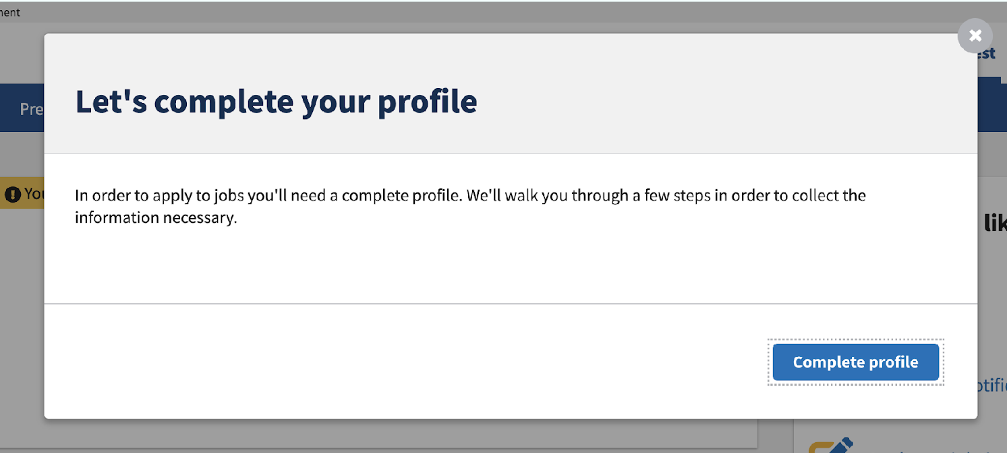
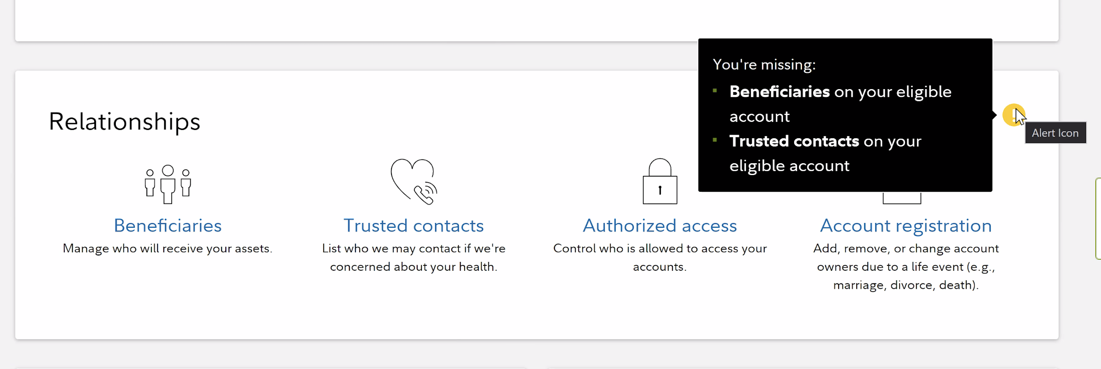
Interrupt modals and notifications are common approaches to encourage people to complete their profile information.
Research Findings
8 of the 15 sites we visited had a UX to encourage profile completeness. The approach was varied across the sites, from a small warning icon next to missing information to redirecting users to a full page or modal dedicated to providing missing information.
Almost all allowed users to proceed onto other tasks by closing notifications or choosing a "remind me later" option.

Slide 30
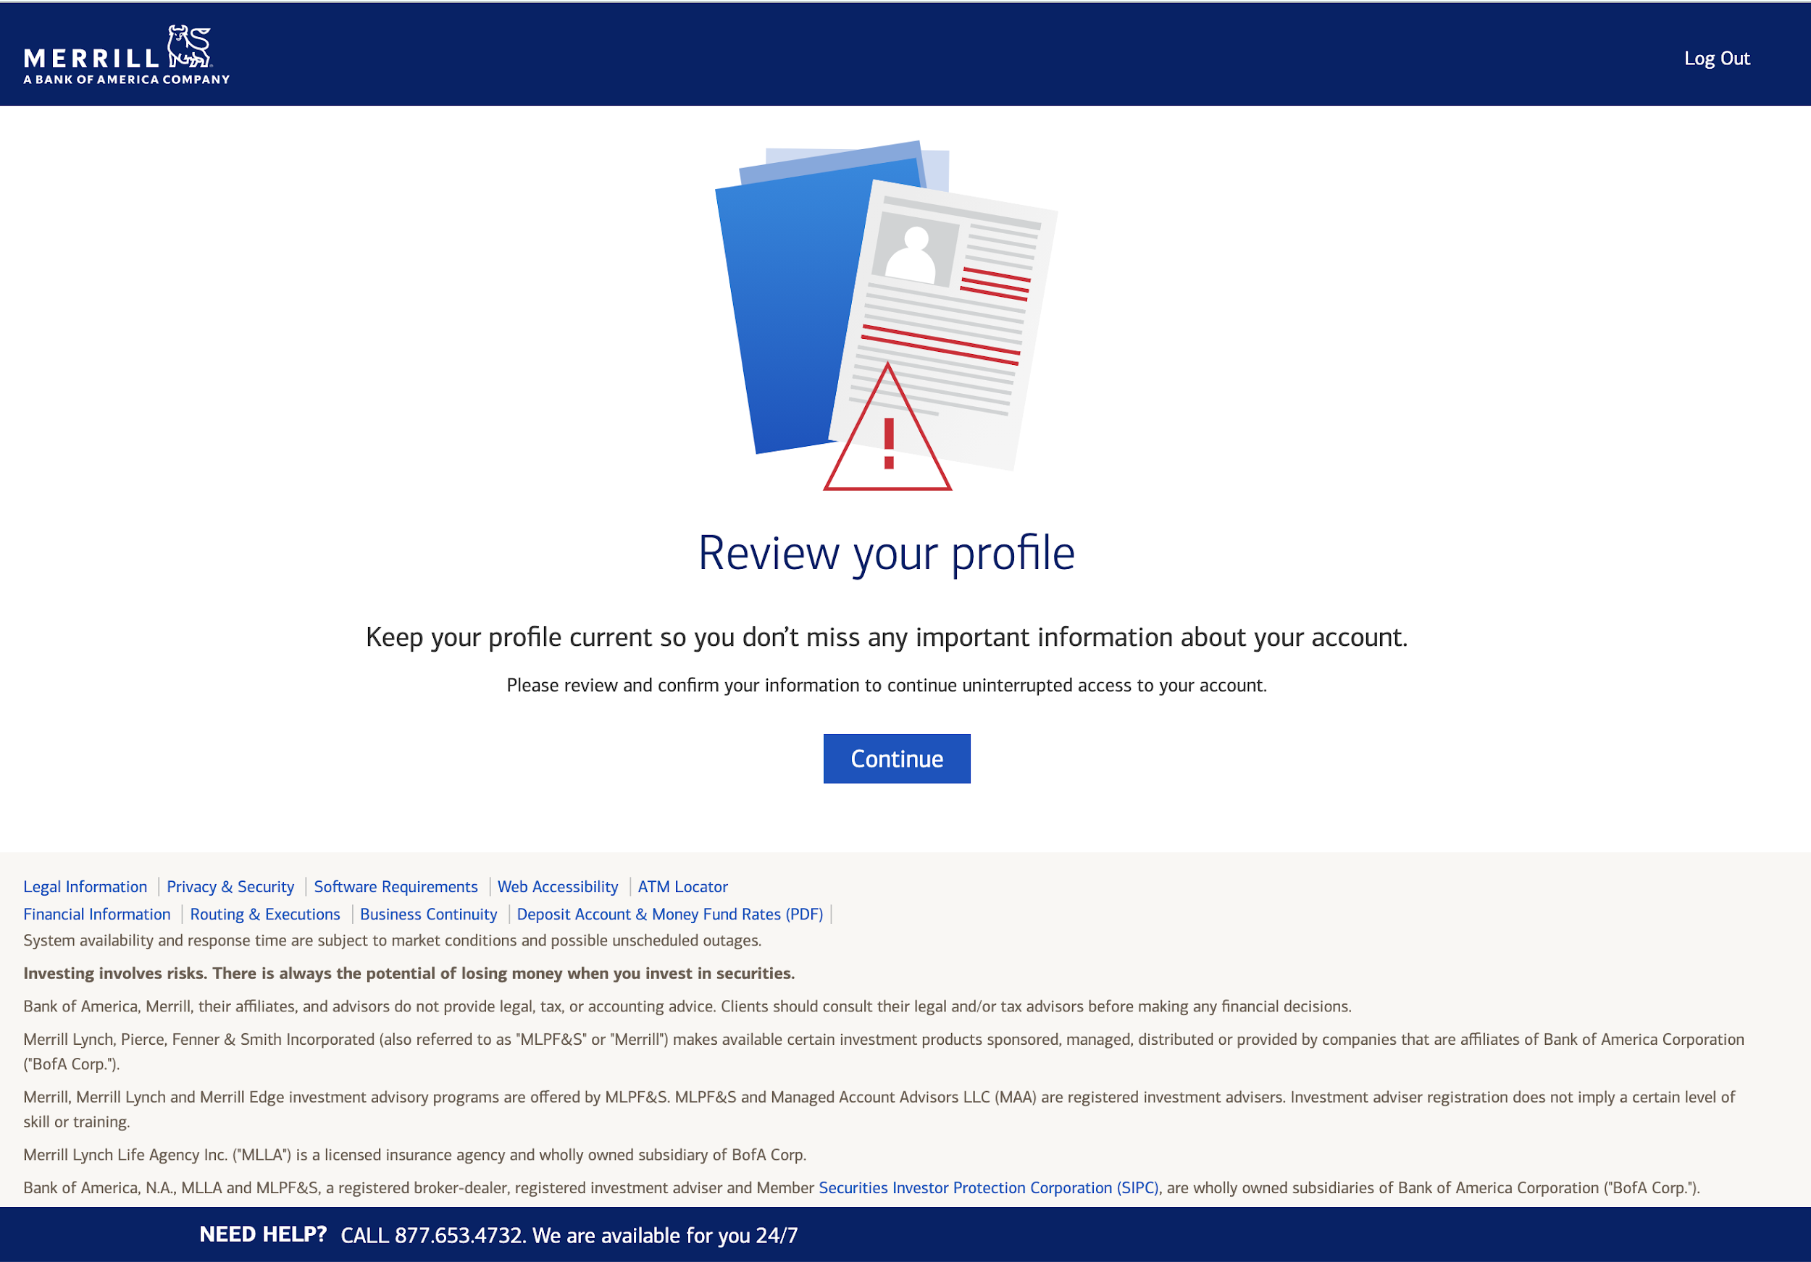
Example of site takeover to encourage profile completeness
Research Findings

Slide 31
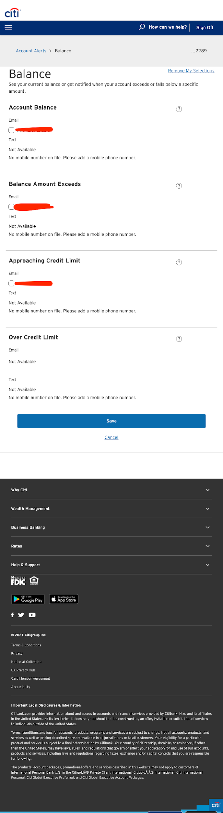
Example of site encouraging profile completeness.
Research Findings
Citicards lets the user know the text notification is not available because the user doesn’t have a mobile number on file. However, this falls short because they do not provide an easy way to add one.

Slide 32
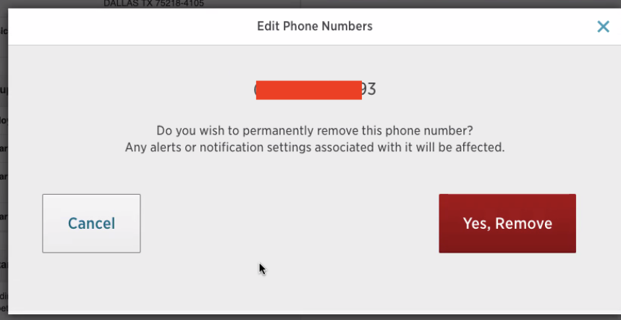
Most sites don't allow people to remove primary contact information from their profile.
Research Findings
Primary contact information (email, phone, address, etc) couldn't be removed from the profile on 11 of the sites we looked at. 3 of those sites did allow removal of secondary contact information, such as a second phone number.
Recently, VA.gov exposed the remove functionality by moving it outside of edit mode, so we wanted to see how that compared to other sites. Of the sites we looked at that allow removal of contact information:
2 had the remove functionality next to an edit button.
3 had the remove functionality nested within the edit function.
All showed something similar to VA.gov's "Are you sure?" modal, explaining the consequences of the removal action.

Slide 33
The sections of the VA.gov profile are well aligned with other sites.
Research Findings
VA.gov's profile has 4 sections that are aligned with sites we visited:
Account security
Personal information
Contact information
Notification settings
Terminology and IA was slightly different in some cases (e.g. "Security settings" instead of "Account security", or "Personal and contact information in one section"), but not so different that changes are recommended. Generally, these are sections people most likely expect to find in a modern, personalized, digital experience.
Some sites had a "Documents" section in their personalized section; this is the only section we identified that could be a useful addition to the VA.gov profile.

Slide 34
3. GOV.UK

Slide 35
GOV.UK is in early stages of personalized user experience.
Research Findings
Our VA.gov team frequently looks to GOV.UK for inspiration, so we wanted to learn more about how they approach personalization . Their Accounts team is in the beginning stages of that work, which includes:
A "Save your work and return" flow for applications
Letting people sign up for notifications on certain pages (e.g. COVID travel updates)
Running experiments to refine technical execution by putting work-in-progress on staging and only testing internally or with a private, invite-only beta testing group.
Since personal data comes up, they frequently do audio-only calls and monitor analytics during testing to track activity
Exploring how they might reflect the fact that some content is relevant and some isn't (e.g. if you live in Scotland vs. England)
Exploring how to handle accounts across government agencies.

Slide 36
Recommendations

Slide 37
Continue working toward making My VA the logged-in homepage.
Recommendations
The goals we've outlined for My VA are aligned with Veterans’ needs, and modern public and private sector site experiences. We should continue working toward the goal of providing Veterans with a task-based, personalized landing page upon logging in.

Slide 38
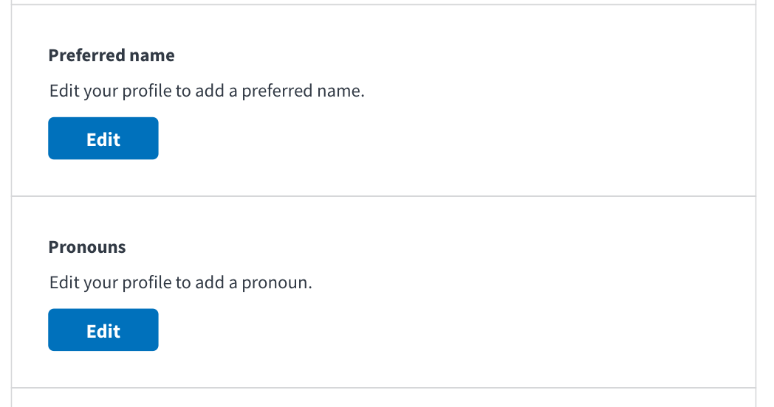
Reevaluate the way we encourage people to complete their profile information.
Recommendations
To start this process, we'll need to consider how a complete profile can improve a Veteran's experience with VA, and how that aligns with OCTO's North Star goals.
Our current approach is light, with a simple "Edit your profile to add a [missing data]". While this has the benefit of being unobtrusive, it's easy to skip over it. We can use design and content to make missing information clearer and better communicate the value to Veterans of adding missing information.
VA.gov profile blank state, December 2021

Slide 39
As a team, let's consider and discuss questions about personalization and civic services.
Recommendations
Personalization is a sensitive and important aspect of the Veteran experience. When it's done well, it can foster trust and greatly improve Veteran self-service. As a team, we have an opportunity to make a dedicated effort for learning more about the work we're doing. This would be particularly valuable when kicking off larger initiatives.
For example, here are some thought provoking questions we encountered in our research:
What are the ethics in government delivering services based on predicting people’s needs?
Which information and services do Veterans actually need to live their lives better?
Is it acceptable if some people choose to opt-in to personalized services, and everyone else gets the standard version? Would this lead to two-tier public services? (And would it matter if it did?)
If it's not appropriate for product teams to spend time on this directly, it could still be beneficial for teams to hear how OCTO considers these types of questions as they establish business objectives.

Slide 40
Incorporate transparency into personalization.
Recommendations
In order to build and maintain trust, we should be transparent about how we know things about Veterans and how their data is being used. It can feel creepy when websites seem to know things about you and it's not clear how they know that. And, it can feel invasive when websites ask for your information without making the reason for asking clear.
In our recent personal information update, we added an FAQ to let Veterans know why we're asking for this information. This is a good example of transparency and what we can continue to do moving forward. As we add roll out features related to personalization, we should ensure to get Veteran feedback to understand the level of transparency they expect and need to maintain trust in VA.

Slide 41
Appendix

Slide 42
Articles
5 things to think about when personalizing government digital services
Reimagine an age of more personalized services for citizens
Accenture's 2019 Tech Trends, Trend 2 "Get to Know Me" (page 29)
What if public services could be more like Amazon’s?
Creating a personalized, digital experience in government
Introducing GOV.uk accounts
Using accounts to personalize the experience on GOV.uk
How we designed the GOV.uk accounts trial
Five things we learned from researching the GOV.uk account

Slide 43
Documentation
Research plan

